Slide 1

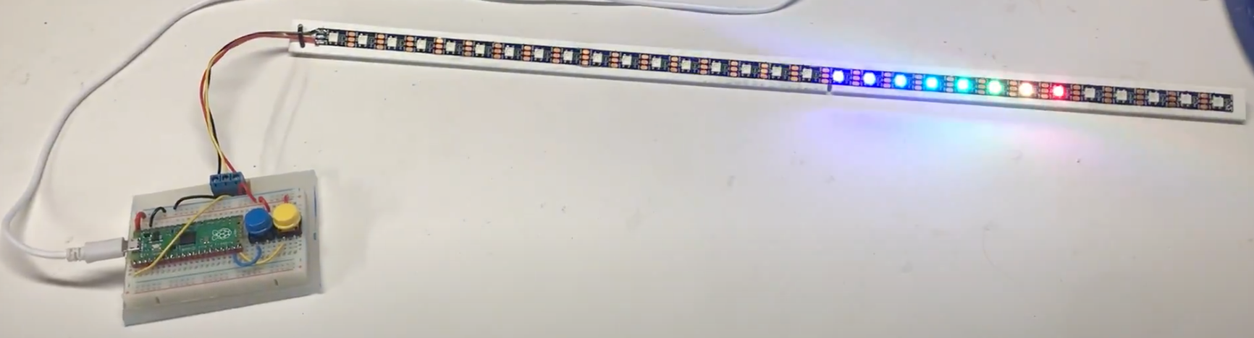
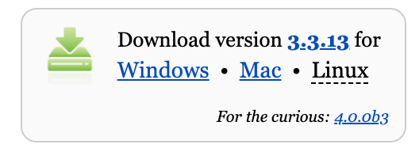
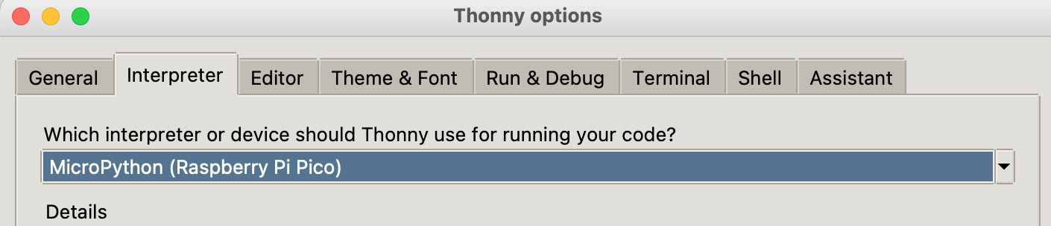
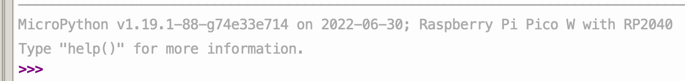
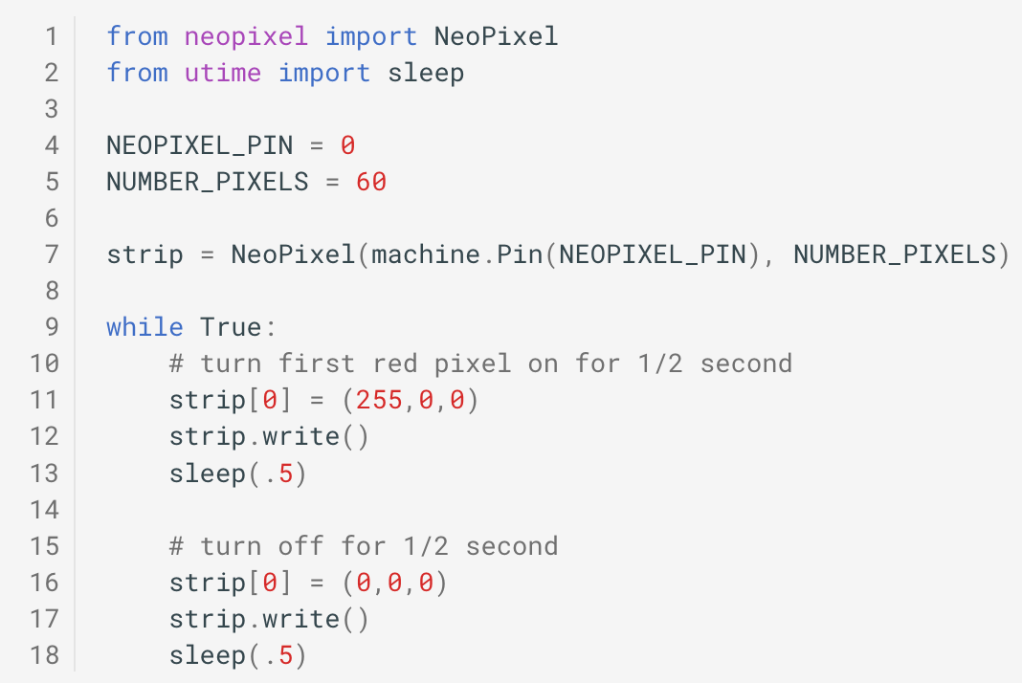
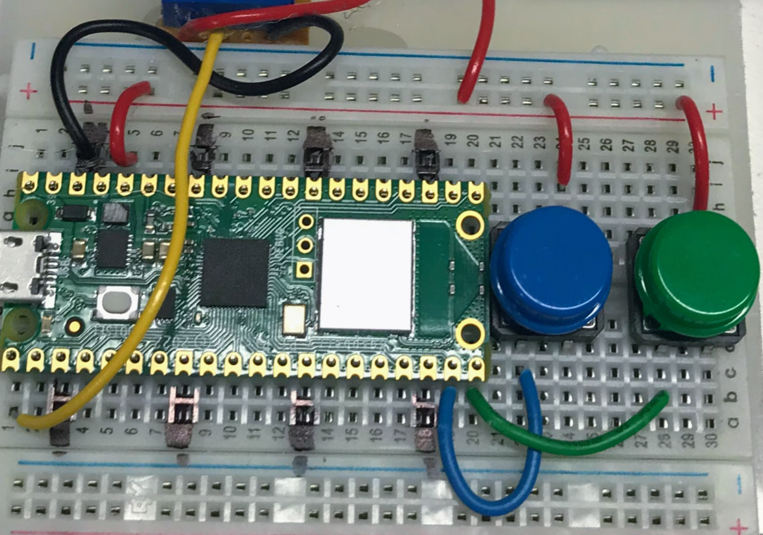
Paith’s LED Class
Moving Rainbow
Kit Contents
Raspberry Pi Pico “W” - $6
Breadboard - $1.50
2 momentary switches – 5 cents each
Screw header - 20 cents
LED strip (SW2812B) – $4 to $7.5
Step 1: Use buttons to change the mode
What do the buttons do? Do they go forward and backward in pattern?
How many ”modes” are there? What is your favorite pattern?
Step 2: Install Thonny on your Mac or PC
Go to https://thonny.org
Download the version for your PC or Mac
Set the Interpreter to be MicroPython (Raspberry Pi Pico)
Step 3: Connect the USB to the Pico
Connect the USB from your PC to the Pico
Press Stop/Reset and check prompt
Step 4: Find the Blink program
http://dmccreary.github.io/moving-rainbow
Mode Buttons
Step 4: Run the Blink Program
FWD
REV

Slide 2
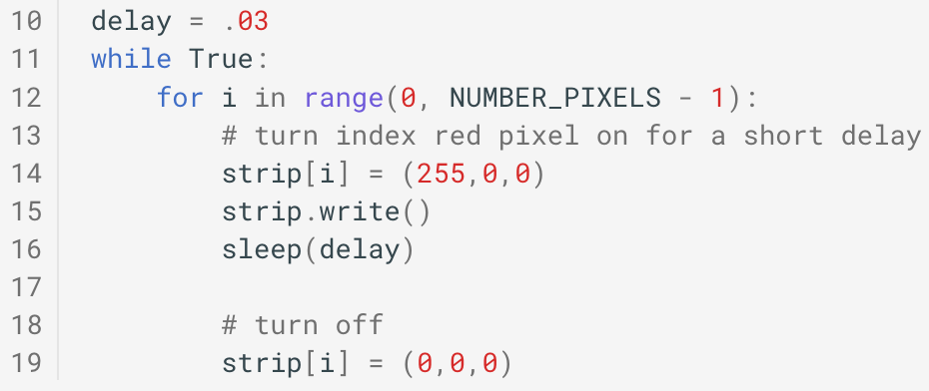
MicroPython NeoPixel Code Examples
Sample Preamble
from neopixel import NeoPixel
from utime import sleep
NEOPIXEL_PIN = 0
NUMB_PIXELS = 60
strip = NeoPixel(machine.Pin(NEOPIXEL_PIN), NUMB_PIXELS)
Sample Moving Pixel
Color Codes
red = (255, 0, 0)
orange = (140, 60, 0)
yellow = (255, 255, 0)
green = (0, 255, 0)
blue = (0, 0, 255)
cyan = (0, 255, 255)
indigo = (75, 0, 130)
violet = (138, 43, 226)
purple = (255,0,255)
white = (128, 128, 128)
off = (0,0,0)
Sample Labs
http://dmccreary.github.io/moving-rainbow/lessons
Press the forward (FWD) and back (REV) mode buttons to change the pattern
Get "blink" lab to work
Change the color of the blink lab
Change the “delay” time in the blink lab – what happens around 0.01 seconds?
Make a single pixel fade in and out
Simulate a heartbeat pattern (on for 1/10 of a second, off for 1.5 seconds)
Make a pixel appear to move from one pixel to the next
Change the color and speed of the moving pixel
Try one of the 20 patterns in the lessons section
Add debug code to the button press code. Use another pin for the buttons.
Try all the modes
Create your own mode pattern
Learn how to solder solid wires to ends of an LED strip or battery pack
Hook up a battery to breadboard rails
Connect 5v, GND and DATA wires and verify the LED strip works
Hook up LED circuit in series with 330-ohm resistor
Create a web page and use it to control the colors of the LED strip
Use your phone to change the colors of the LED strip
Create a program that gets the weather report from a web service
Hook up an OLED display to your kit and practice some drawing
Walk around and ask people about their career and what they enjoy
Visit the CoderDojoTC Micropython site: https://www.coderdojotc.org/micropython

